Slide 1
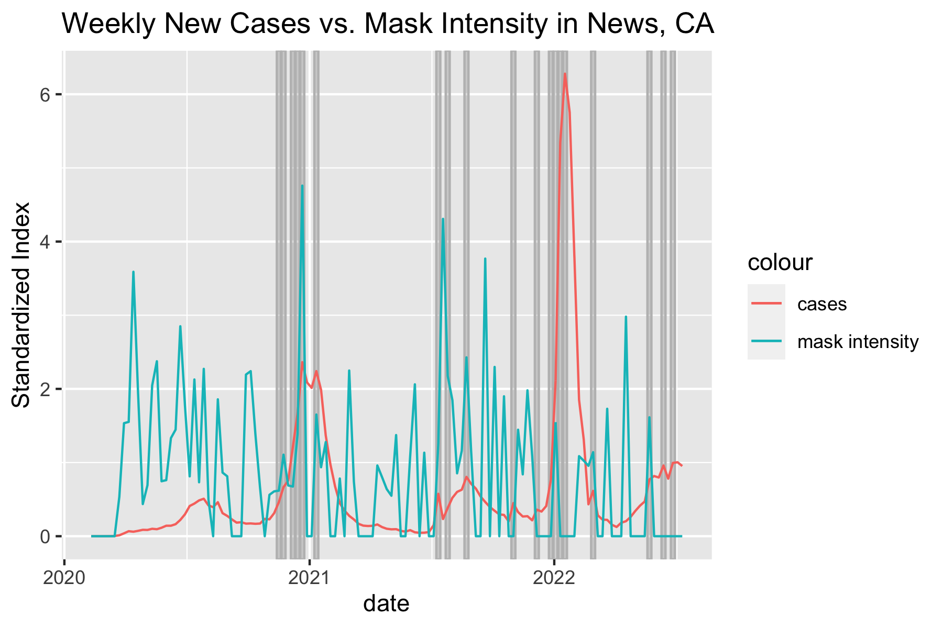
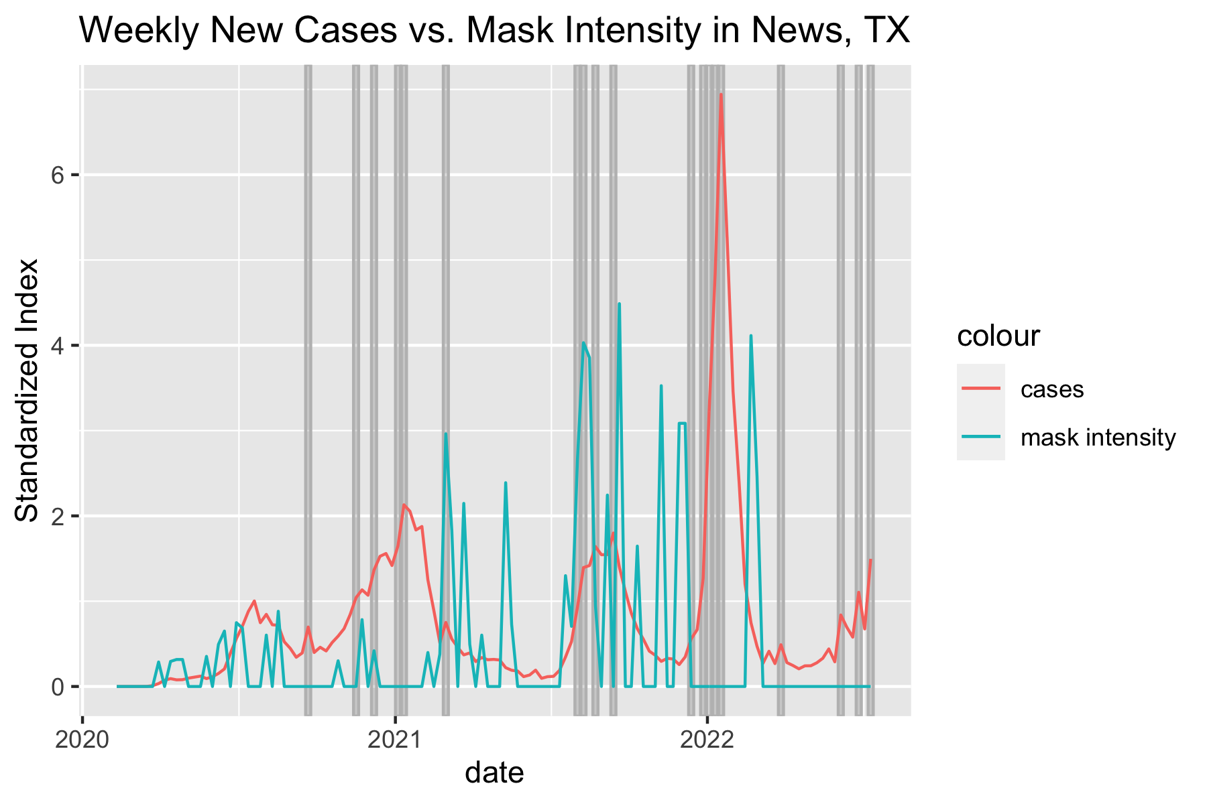
Team: team33
Vivian Zhang, Bo-Yu Chen, Boyie Chen
Please use the remaining area to display your impression figures!
(Please delete all the instruction boxes when you submit the result)
The impression figures should be displayed in 1 page.
The font size should be no smaller than 18 pt in slides.
Please use the same typeface (Arial or Helvetica) for all fonts. Use symbol font for Greek letters.
To achieve best visual result, please make sure you provide high resolution images and use distinct colors with comparable visibility and avoid the use of red and green for contrast. Recoloring primary data, such as fluorescence images, to color-safe combinations.
Do Blue & Red States Differ in Mask-related Topics?

